Slide 1
Used Car Market Around Clemson, SC: Prices and Predictors
Alex Matandos

Slide 2
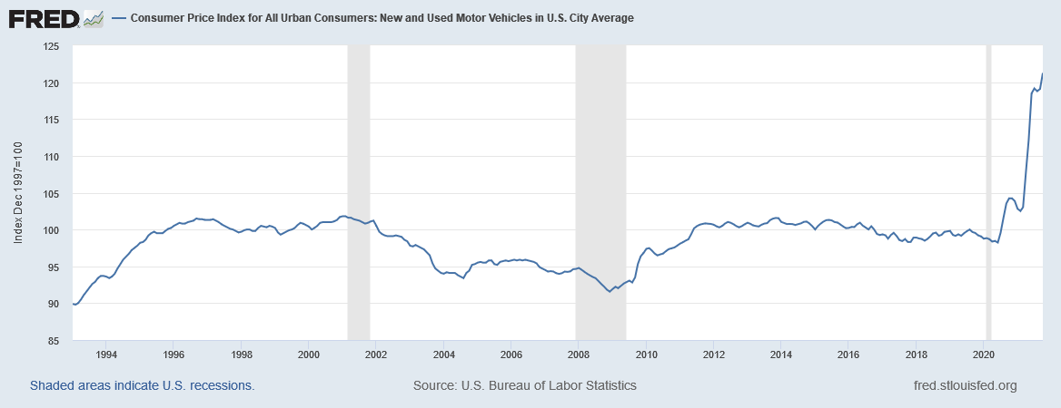
Introduction

Slide 3
Introduction
From June 2020 to October 2021: a 23.4% increase for new and used vehicles!;
Causes?
Rising Energy Prices?
Disruption of Global Supply Chains?
Hoarding by Owners?
Geopolitical Instability?
Regardless of the reason, it seems an interesting time to revisit the car market;

Slide 4
Introduction
Dataset: used cars around Clemson, SC, scraped from craigslist:
471 observations;
19 variables (model, year, fuel, price, mileage, color, and so forth);
Predictors of price, on logarithmic scale.

Slide 5
Literature Review
Akerlof (1970), outcomes under information assymetry; used car market as example:
Only sellers are able to know the car’s true condition;
Thus, buyers, oblivious to the above, face “lemons” at the same prices as good used cars;
Parallels to Gresham’s Law: bad cars drive out the good cars out of the market.

Slide 6
Literature Review
Kim (1985), expands on Akerlof (1970):
Unlike other sectors (e.g. insurance), buyers and sellers may shift roles;
Quality is endogenous (function of maintenance level);
Two periods; all agents start with no car; maintenance level when cars is new (first period) is king;
von Neumann-Morgenstern utility;
Better cars now may be sold, not only “lemons”.

Slide 7
Literature Review
Berry, Levinsohn, and Pakes (1995), empirical analysis; cost and demand parameters over twenty year period for the US car market:
Similar to hedonic pricing regressions (power-weight ratio, AC, MPG, and trend);
All parameters are positive except for MPG.

Slide 8
Data Description
Requested and scraped webpages of used car advertisements on craigslist, on November 21, 2021:
“Uncleaned” data features 519 observations (i.e. double entries, other advertisements, and so forth);
“Cleaned” data: 471 observations;
Variables: price, mileage, manufacturer and model, year, engine cylinders, drivetrain, paint color, size, type, condition, VIN, and nationality (Germany, Japan, or USA).

Slide 9
Data Description
Short summary of sample:
Average asking price: $13,006;
Average odometer reading: 139,614 miles;
Average car is 15.69 years old;
“Like new” and “excellent” cars represent 38.85% of sample;
Nationality:
USA: 21.02%;
Japan: 28.66%;
Germany: 9.554%.

Slide 10
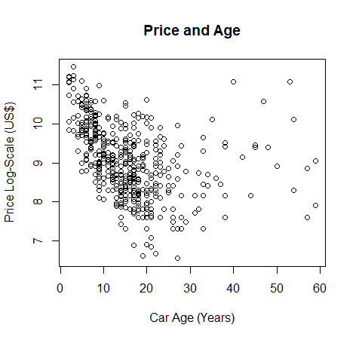
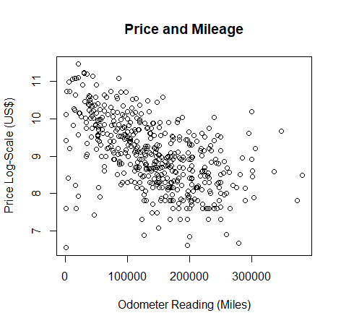
Data Description

Slide 11
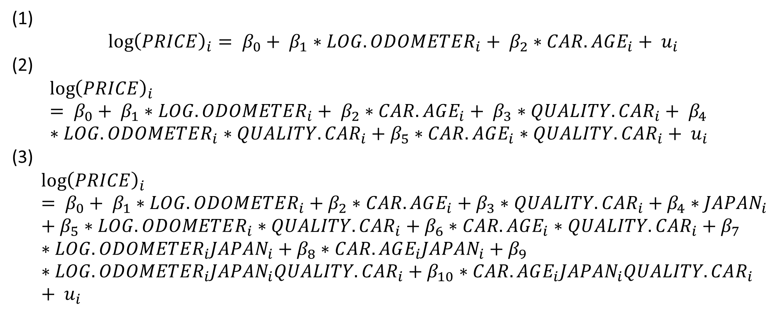
Methods
(1)
$${\log\left(PRICE\right)}_{i}= β_{0}+ β_{1}∗LOG.ODOMETER_{i}+ β_{2}∗CAR.AGE_{i}+ u_{i}$$
(2)
$${\log\left(PRICE\right)}_{i}= β_{0}+ β_{1}∗LOG.ODOMETER_{i}+ β_{2}∗CAR.AGE_{i}+ β_{3}∗QUALITY.CAR_{i}+ β_{4}∗LOG.ODOMETER_{i}∗QUALITY.CAR_{i}+β_{5}∗CAR.AGE_{i}∗QUALITY.CAR_{i}+ u_{i}$$
(3)
$${\log\left(PRICE\right)}_{i}= β_{0}+ β_{1}∗LOG.ODOMETER_{i}+β_{2}∗CAR.AGE_{i}+β_{3}∗QUALITY.CAR_{i}+β_{4}∗JAPAN_{i}+β_{5}∗LOG.ODOMETER_{i}∗QUALITY.CAR_{i}+β_{6}∗CAR.AGE_{i}∗QUALITY.CAR_{i}+β_{7}∗LOG.ODOMETER_{i}JAPAN_{i}+β_{8}∗CAR.AGE_{i}JAPAN_{i}+β_{9}∗LOG.ODOMETER_{i}JAPAN_{i}QUALITY.CAR_{i}+β_{10}∗CAR.AGE_{i}JAPAN_{i}QUALITY.CAR_{i}+ u_{i}$$

Slide 12
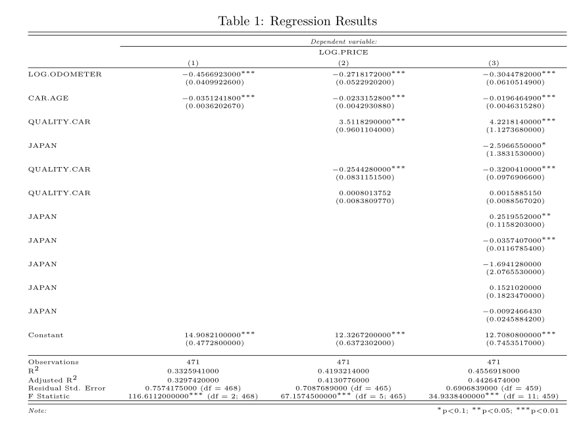
Results

Slide 13
References:
Akerlof, George A. “The Market for "Lemons": Quality Uncertainty and the Market Mechanism”. The Quarterly Journal of Economics 84, no. 3 (August 1970), 488-500.
Berry, Steven, James Levinsohn, and Ariel Pakes. “Automobile Prices in Equilibrium”. Econometrica 63, no. 4 (July 1995), 841-890.
Jae-Cheol, Kim. “The Market for "Lemons" Reconsidered: A Model of the Used Car Market with Asymmetric Information”. The American Economic Review 75, no. 4 (September 1985), 836-843.
FRED. “Consumer Price Index for All Urban Consumers: New and Used Motor Vehicles in U.S. City Average”. Accessed November 21, 2021.

